Slide 1
Flu in the U.S.: A Closer Look
Python Data Analysis
By: Morgan, Qin, Ryan and So Jung

Slide 2
Our Questions
Our Data
What determines how bad a flu season will be?
What socio-economic, environmental, or other factors contribute to people receiving the flu?
Which states or regions are more susceptible than others?
US Census Data (API)
CDC ILI Data (CSV)
Google Maps (API)
Other specific CDC datasets (Mortality, Hospitalization)

Slide 3
Overview
Background on ILI - symptoms, how it’s spread, etc.
Nationwide five year historical analysis (2013-2018 flu season) and 2019 flu season to-date
State-by-state five year historical analysis - closer look at the top five states that have the highest rates of flu and vice versa
Analysis of independent variables against the occurrence of flu and any correlations in the data (or lack thereof)
Socio-economic
Distance from equator
Highlight 2017-18 flu season - worst in the last five years - what went wrong?
Current year to-date analysis (?)
**Data is normalized for disperates in state population

Slide 4
Flu and Influenza-Like-Illnesses
Influenza (flu) is a contagious respiratory illness caused by influenza viruses. It can cause mild to severe illness. Serious outcomes of flu infection can result in hospitalization or death.
ILI is defined as fever (temperature of 100°F [37.8°C] or greater) and a cough and/or a sore throat in the absence of a known cause other than influenza.
Flu spreads person to person. (Young kids and their parents, school and daycare providers, and healthcare workers are more likely to get flu).
Notes:
Outpatient Illness Surveillance — Information on patient visits to health care providers for influenza-like illness is collected through the U.S. Outpatient Influenza-like Illness Surveillance Network (ILINet). ILINet consists of approximately 3,200 outpatient healthcare providers in all 50 states, Puerto Rico, the District of Columbia and the U.S. Virgin Islands reporting over 36 million patient visits each year. Each week, approximately 2,000 outpatient healthcare providers around the country report data to CDC on the total number of patients seen and the number of those patients with influenza-like illness (ILI)

Slide 5
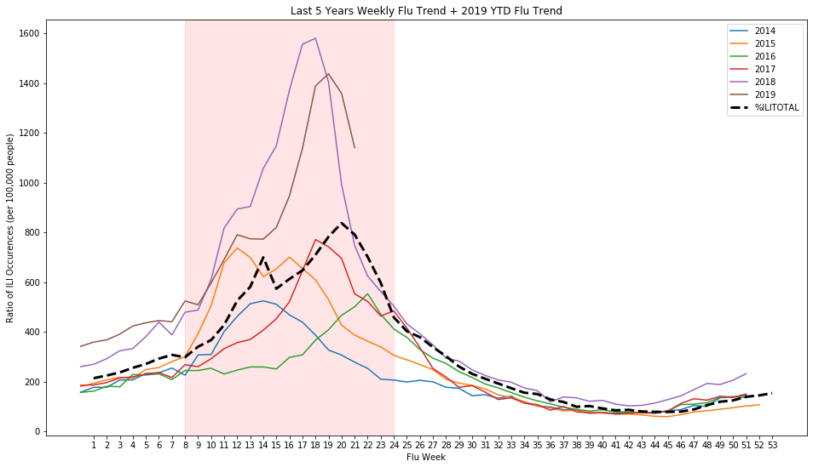
Nationwide 5-year Historical Flu Occurrence + 2019 YTD
“Flu Seasons” are defined as October 1st through September 30th (Q4 - Q3).
The 2018 flu season was considered an epidemic, rising far above the 2014-2017 flu seasons.
The 2019 flu season was not far behind the numbers recorded in 2018.
The highlighted period represents the worst part of the flu season.

Slide 6
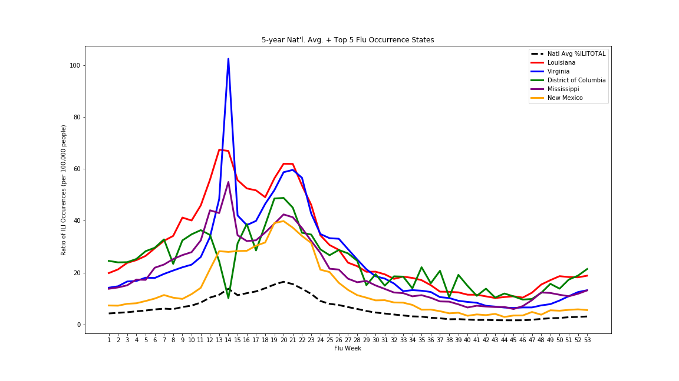
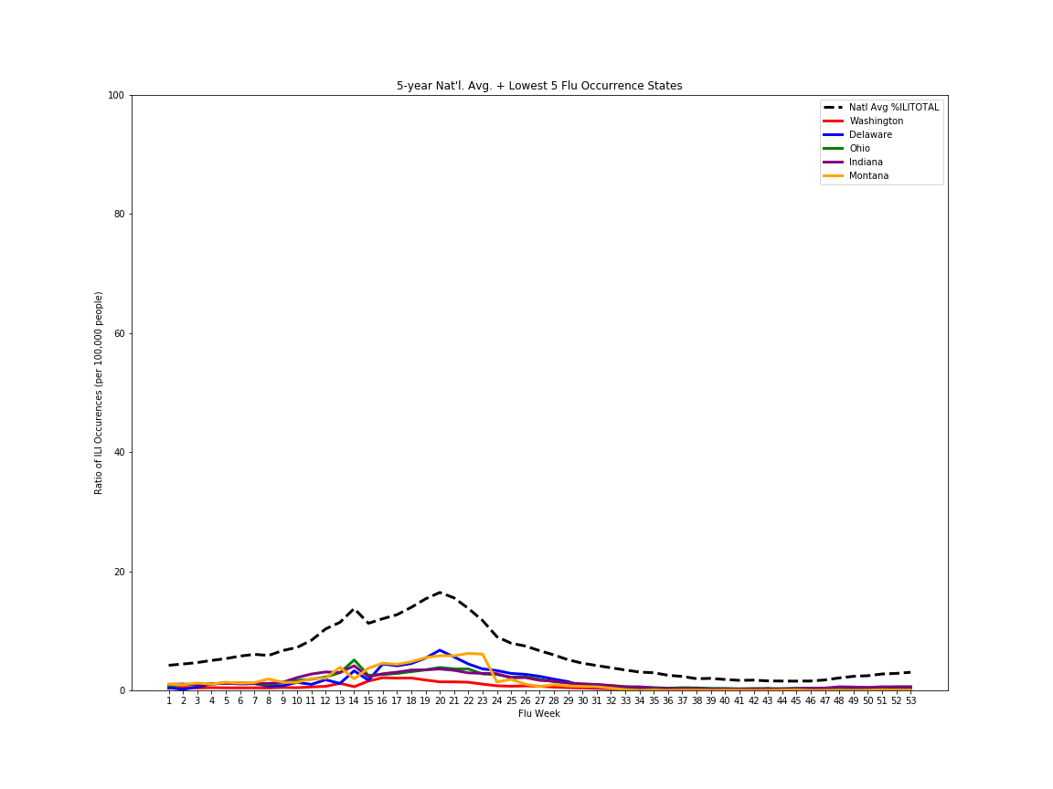
State Analysis - Top and Bottom 5

Slide 7
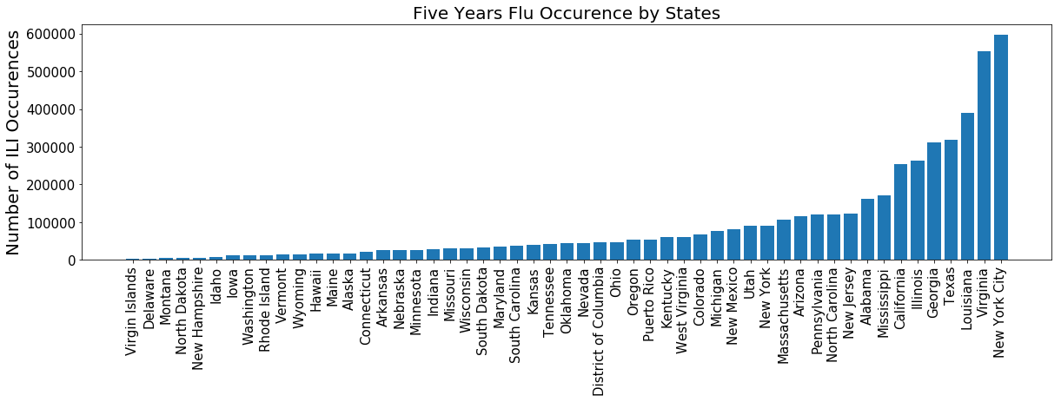
State Analysis - The Best and the Worst
[INSERT STATE ANALYSIS]

Slide 8
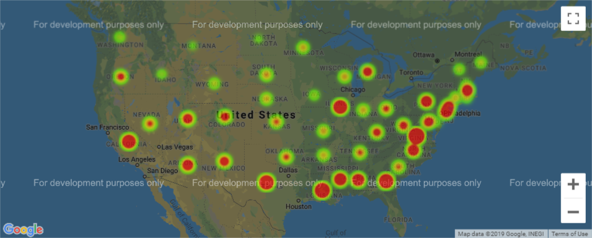
State Analysis - The Best and the Worst
[INSERT STATE ANALYSIS]
Notes:
Using google API to get flu map

Slide 9
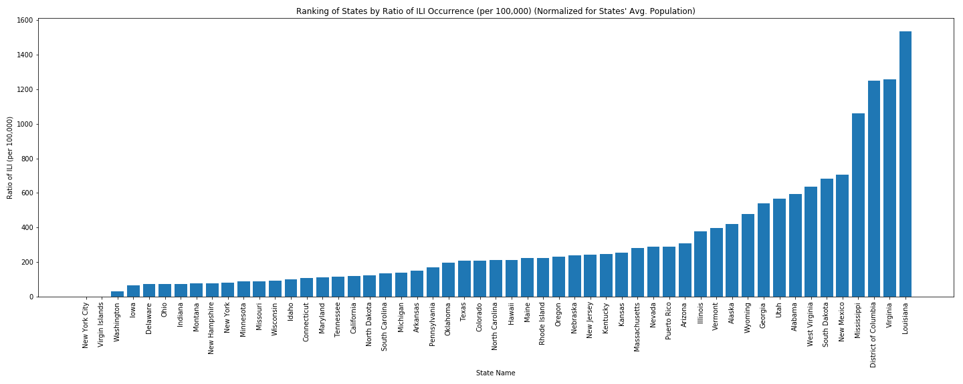
State Analysis - Weighted by State Population
Notes:
Using census API to get state population numbers.
The percentage of patient visits to healthcare providers for ILI reported each week is weighted on the basis of state population
Then ILI ratio reduced in states with large population base, such as California, while ratio increased in states located in the middle northwest.

Slide 10
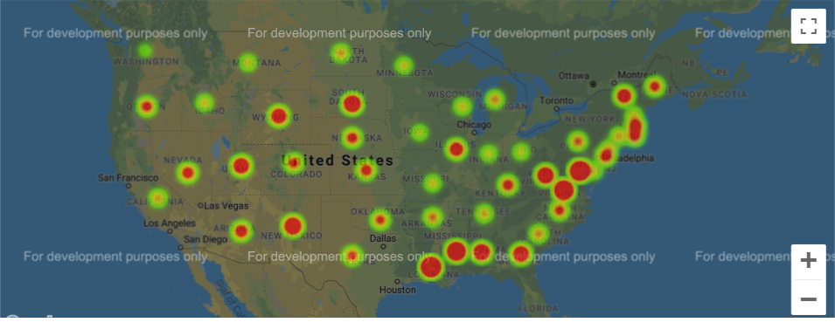
State Analysis - Weighted by State Population
[INSERT STATE ANALYSIS]
Notes:
Using census API to get state population numbers.
The percentage of patient visits to healthcare providers for ILI reported each week is weighted on the basis of state population.

Slide 11
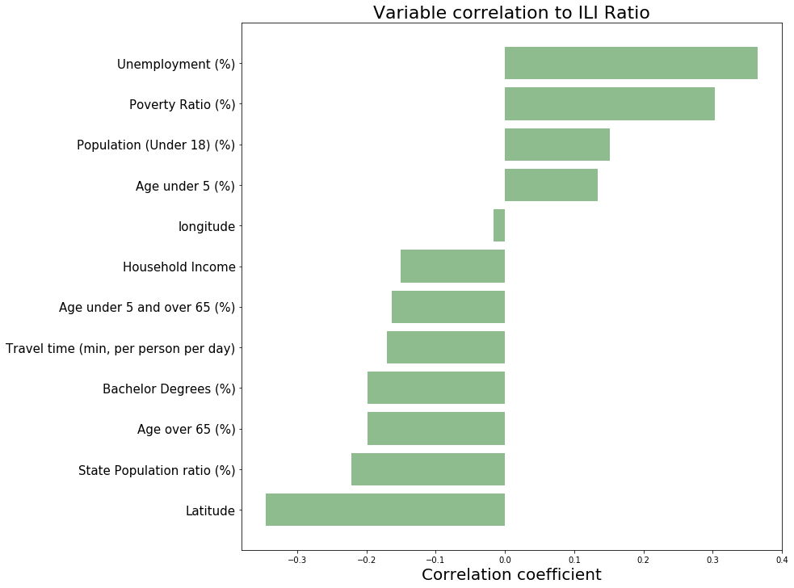
Statistical Analysis of Possible Correlations
Correlation -1 to 1
-0.1 to 0.1 None or very weak
-0.3 to -0.1 or 0.1 to 0.3 Weak
-0.5 to -0.3 or 0.3 to 0.5 Moderate
-1.0 to -0.5 or 0.5 to 1.0 Strong
Notes:
Pull census data and google geocode, find correlation with flu

Slide 12
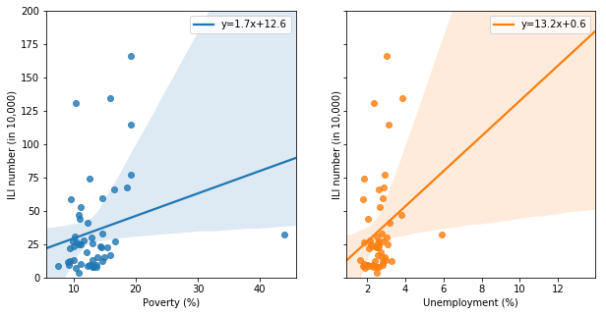
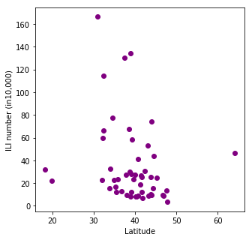
Linear Regression Analysis (moderate r)

Slide 13
ILI & Socioeconomic Variables
Scatter Plots
Select 2 groups of states based on normalized flu numbers:
Higher Flu Occurring States: Louisiana, District of Columbia, Virginia, Mississippi, New Mexico, South Dakota, West Virginia, Alabama, Georgia, Utha
Lower Flu Occurring States: Missouri, Minnesota, New York, Montana, New Hampshire, Indiana, Delaware, Ohio, Iowa, Washington

Slide 14
Spearman’s correlation coefficient r: Non-parametric statistic
 | Spearman’s r (all 50 states) | Spearman’s r (only H/L 20 states) | Pearson’s r (only H/L 20 states)
 | ILI | ILI | ILI
Poverty | .301* (.032) | .373 | .570**(.009)
Unemployment | .412** (.003) | .438 | .610**(.004)
Population(under5) | .174 | .325 | .263
Commuting time | -.111 | -.042 | .048
Bachelor Degree | -.241 | -.295 | .033
Household Income | -.131 | -.185 | -.148
Population(over65) | -.192 | -.388 | -.383
Health Insurance C. | -.276*(.05) | -.632**(.003) | -.711**(.001)

Slide 15
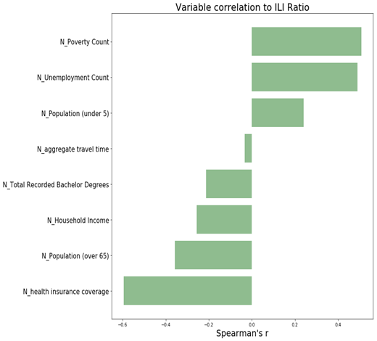
Statistical Analysis of Possible Correlations
(ILI ratio top 10 and bottom 10 states)
Correlation -1 to 1
-0.1 to 0.1 None or very weak
-0.3 to -0.1 or 0.1 to 0.3 Weak
-0.5 to -0.3 or 0.3 to 0.5 Moderate
-1.0 to -0.5 or 0.5 to 1.0 Strong

Slide 16
Independent Sample T-test:
2 Groups (H/L) Mean Difference Test
Ttest_indResult
(statistic=7.162174757736166, pvalue=1.14099114481584e-06)

Slide 17
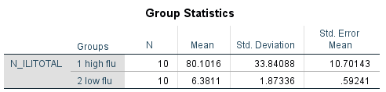
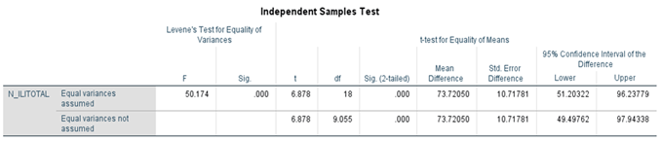
Independent Sample T-test:
2 Groups (H/L) Mean Difference Test

Slide 18
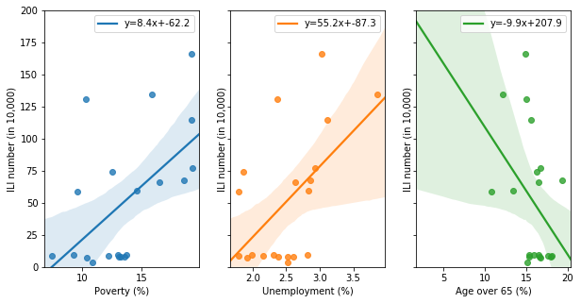
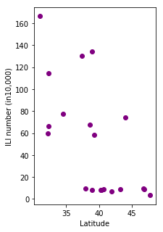
Linear Regression Analysis
(moderate to strong r)

Slide 19
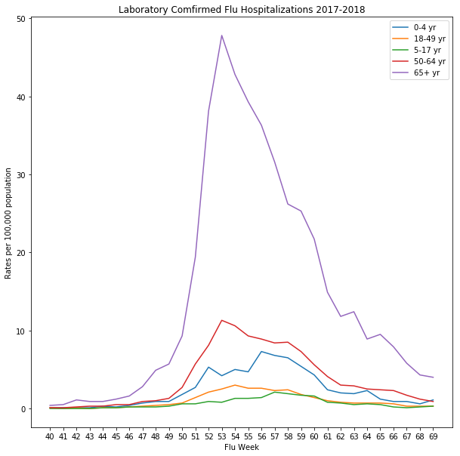
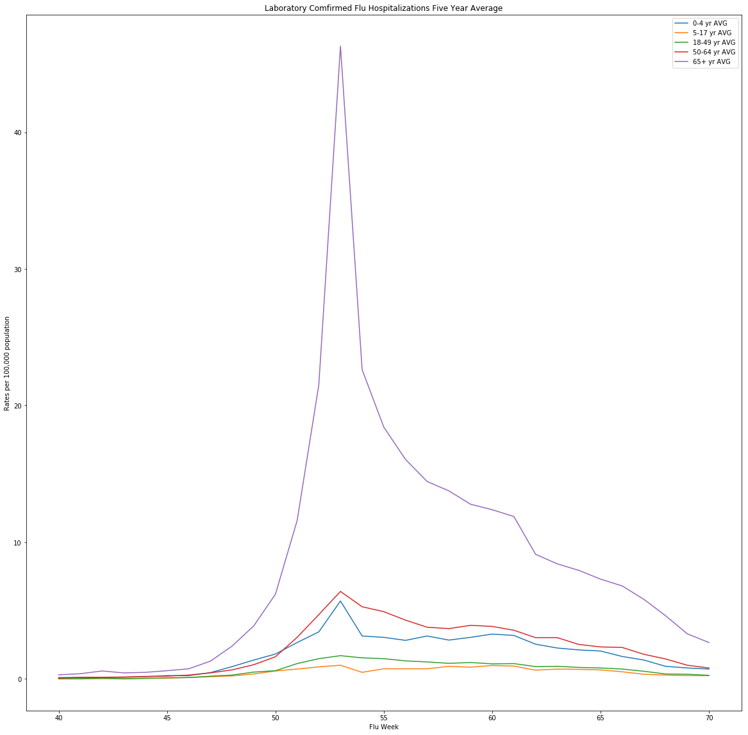
Flu Hospitalization Rates by Age

Slide 20
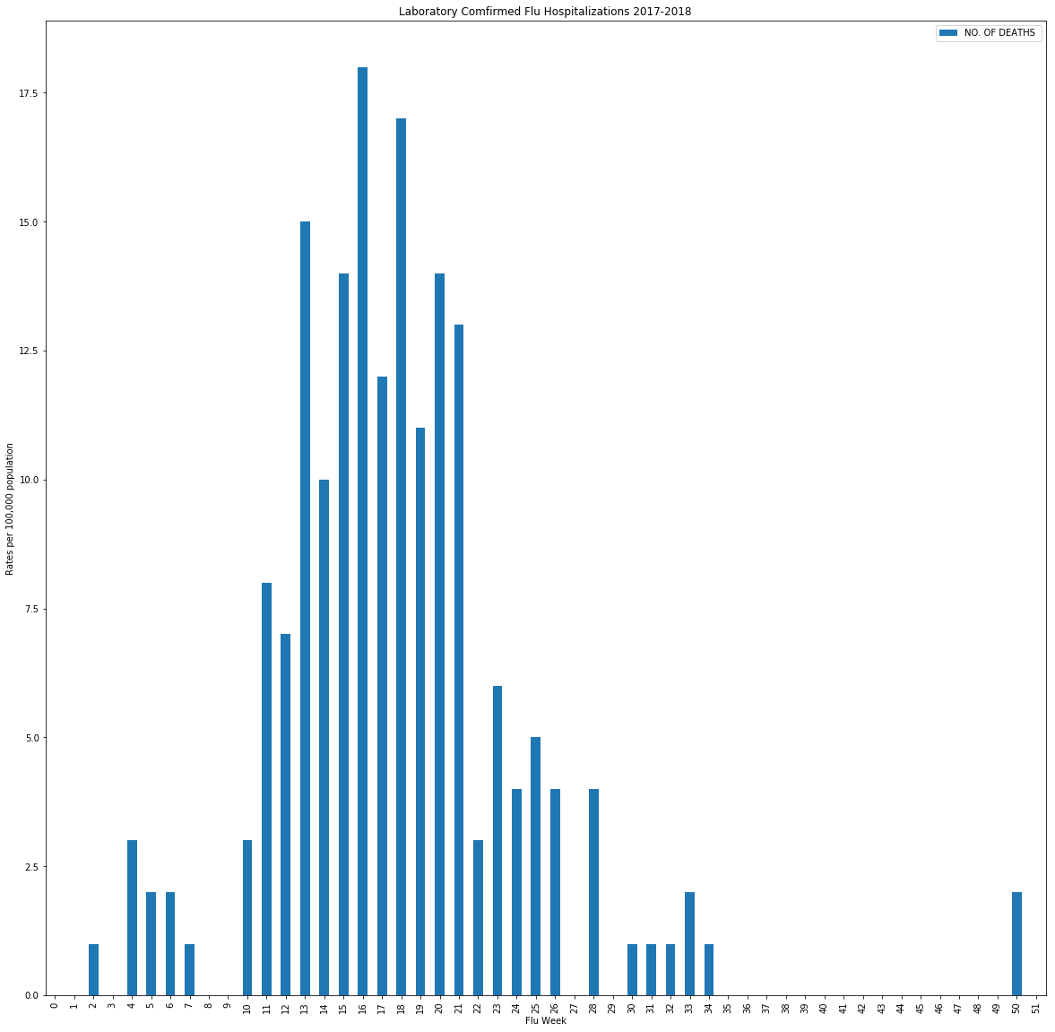
Flu Mortality Rate for the 2017-2018 Season

Slide 21

Summary Findings
There are hundreds of independent variables that determine whether or not flu increases or decreases whether or not someone gets the flu. We determined at the state level that unemployment, poverty, and latitude have a possible effect on flu infection.le
Identified certain states that seem to have higher and lower rates of flu year-over-year
Top: VA, LA, MS, NM, DC
Bottom: WA, DL, MT, OH, IN
If we had more time, we would want to look at other factors such as humidity, flu vaccine coverage, stress, and squirrel population.
WASH YOUR HANDS AND USE HAND SANITIZER!

Slide 22
References
Link to public GitHub repo (https://github.com/Qgui36/first-project)
CDC links
Census links
Google Maps API link

